Slide 1



DS4 - Product
View in Power BI
Last data refresh:
15-09-2023 05:33:12 UTC
Downloaded at:
25-09-2023 14:42:58 UTC

Slide 2
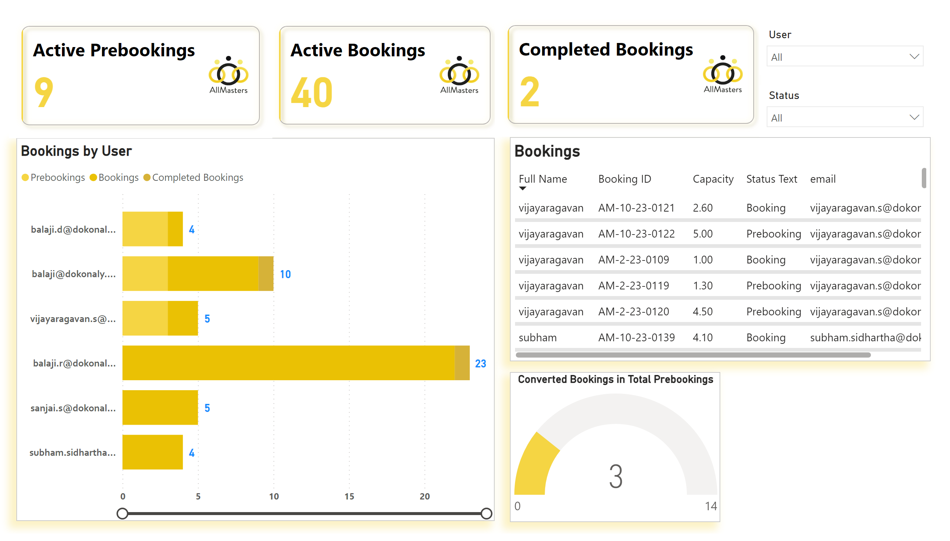
Bookings 1
Notes:
Converted Bookings in Total Prebookings
No alt text provided
slicer
No alt text provided
slicer
No alt text provided
cardVisual
No alt text provided
Bookings
No alt text provided
cardVisual
No alt text provided
cardVisual
No alt text provided
Bookings by User
No alt text provided

Slide 3
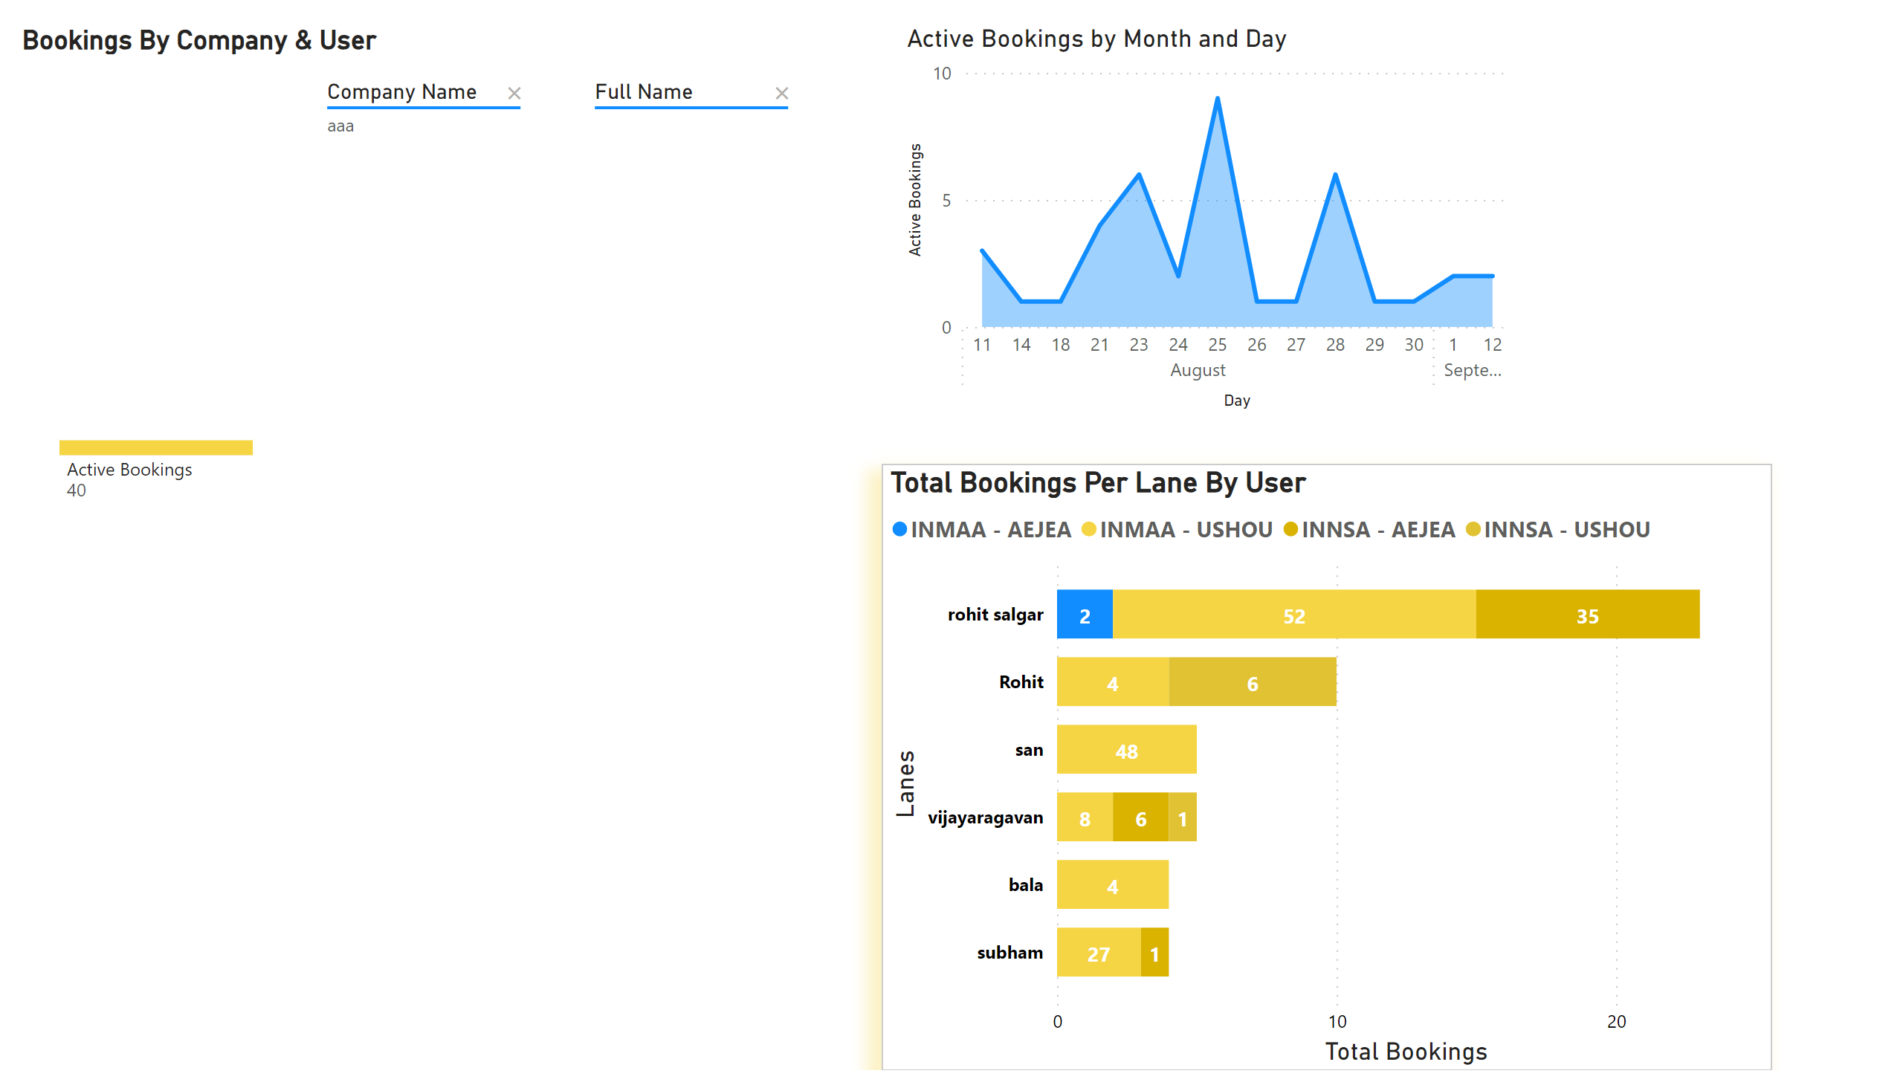
Bookings 2
Notes:
Bookings By Company & User
No alt text provided
areaChart
No alt text provided
Total Bookings Per Lane By User
No alt text provided

Slide 4
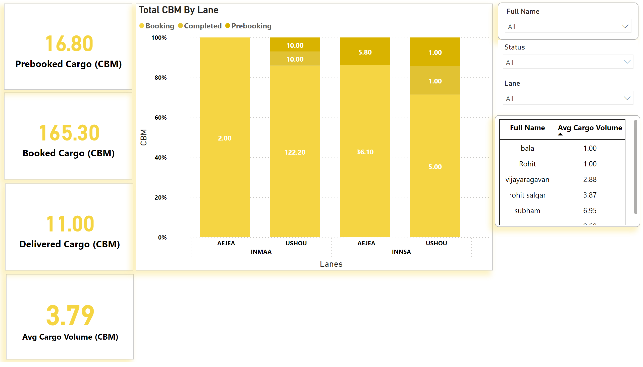
Cargo
Notes:
card
No alt text provided
card
No alt text provided
card
No alt text provided
card
No alt text provided
Total CBM By Lane
No alt text provided
tableEx
No alt text provided
slicer
No alt text provided
slicer
No alt text provided
slicer
No alt text provided

